Slide 1
Recurrence Analysis of Complex Systems
Hui Yang and Yun Chen
Complex Systems Monitoring, Modeling and Analysis Laboratory
University of South Florida

Slide 2
Relevant Publications
H. Yang*, “Multiscale Recurrence Quantification Analysis of Spatial Vectorcardiogram (VCG) Signals,” IEEE Transactions on Biomedical Engineering, Vol. 58, No. 2, p339-347, 2011, DOI: 10.1109/TBME.2010.2063704
Y. Chen† and H. Yang*, "Multiscale recurrence analysis of long-term nonlinear and nonstationary time series," Chaos, Solitons and Fractals, Vol. 45, No. 7, p978-987, 2012, DOI: 10.1016/j.chaos.2012.03.013
H. Yang*, S. T. S. Bukkapatnam, and L. G. Barajas, “Local recurrence model for performance prediction and prognostics in nonlinear and nonstationary systems,” Pattern Recognition, Vol. 44, No. 8, p1834-1840, 2011, DOI: 10.1016/j.patcog.2011.01.010

Slide 3
Outline
Introduction
Recurrence plot
Definition
Structures in RPs
Selection of threshold ε
Modifications and extensions
Cross recurrence plot
Space time separation plot
Recurrence quantification analysis
Extension to spatial data
Notes:
Before the presentation gets started, let’s have a look at the outline.
In the first place, I will talk about research motivation and problem statement.
Next, I will introduce the research background including self-similarity and recurrence dynamics in the heart rhythm
Then we will move to the section of research methodology and experimental results.
In the end I will conclude today’s talk.

Slide 4
Recurrence
Recurrence is a fundamental feature of many nonlinear dynamical systems.
The study of recurrence is critical to understand the dynamics of nonlinear systems.
Natural & engineered systems - distinct recurrence behaviors
Discrete-part manufacturing process
Nonlinear biological systems
“recurs infinitely many times as close as one wishes to its initial state” (Poincaré).
Stamping Machine, from Dr. Jianjun Shi
Biological System

Slide 5
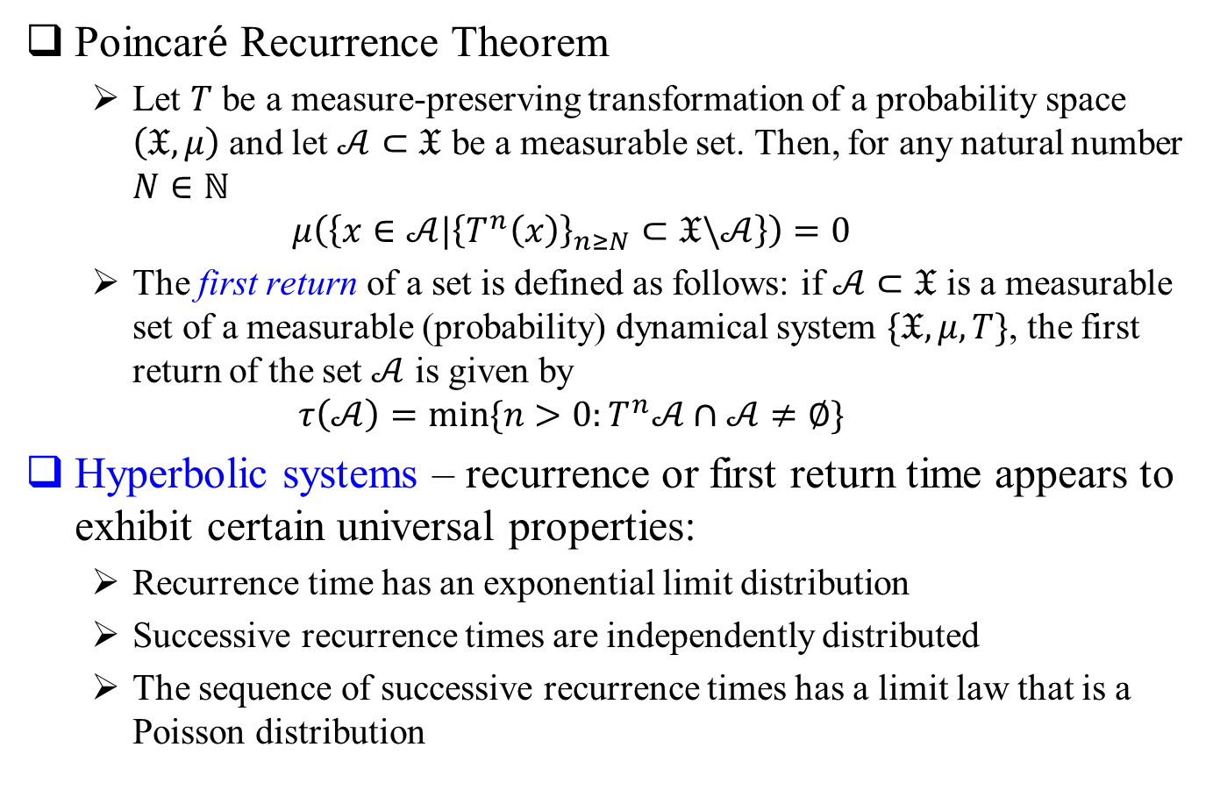

Poincar$\acute{e}$ Recurrence Theorem
Poincar$\acute{e}$ Recurrence Theorem
Let $T$ be a measure-preserving transformation of a probability space $\left(𝔛,μ\right)$ and let $𝒜⊂𝔛$ be a measurable set. Then, for any natural number $N∈ℕ$
$$μ\left(\left\{x∈𝒜|{\left\{T^{n}\left(x\right)\right\}}_{n≥N}⊂𝔛\backslash 𝒜\right\}\right)=0$$
The first return of a set is defined as follows: if $𝒜⊂𝔛$ is a measurable set of a measurable (probability) dynamical system $\{𝔛,μ,T\}$, the first return of the set $𝒜$ is given by
$$τ\left(𝒜\right)=min⁡\{n>0:T^{n}𝒜∩𝒜≠∅\}$$
Hyperbolic systems – recurrence or first return time appears to exhibit certain universal properties:
Recurrence time has an exponential limit distribution
Successive recurrence times are independently distributed
The sequence of successive recurrence times has a limit law that is a Poisson distribution

Slide 6
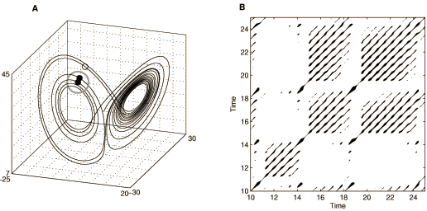
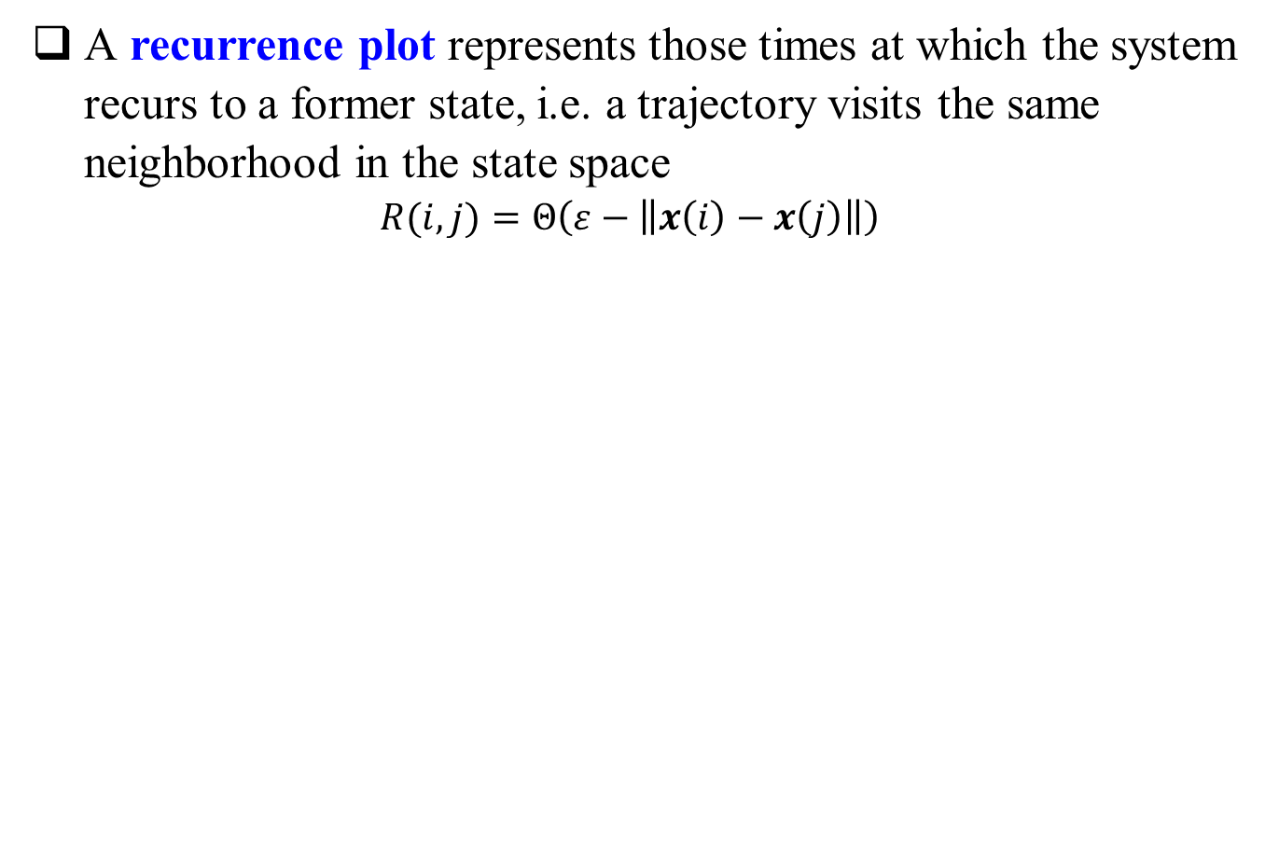
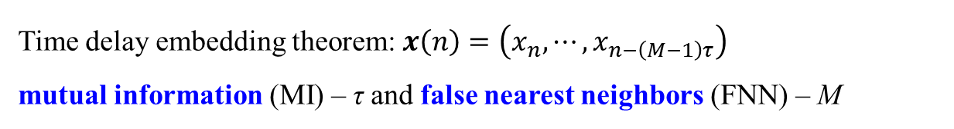
Recurrence Plots
A recurrence plot represents those times at which the system recurs to a former state, i.e. a trajectory visits the same neighborhood in the state space
$$R(i,j)=Θ\left(ε−\left\|x\left(i\right)−x\left(j\right)\right\|\right)$$
Time delay embedding theorem: $x\left(n\right)=\left(x_{n},⋯,x_{n−\left(M−1\right)τ}\right)$
mutual information (MI) – τ and false nearest neighbors (FNN) – M
Notes:
Now, let’s look at the mathematical expressions of recurrence plot.

Slide 7
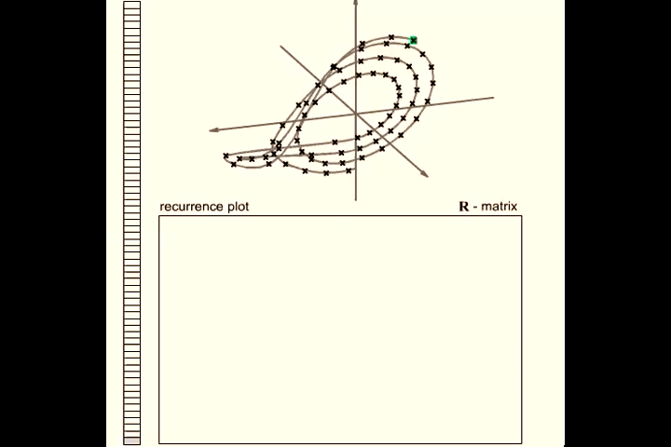
Practical Implementation of RP
N. Marwan, http://www.recurrence-plot.tk/

Slide 8
Structures in Recurrence Plots
Linear System
Nonlinear System
Random System
Small-scale structures
single dots, diagonal and vertical lines
Large-scale structures
homogenous, periodic and disrupted visualization
Notes:
In order to give a clear idea about how recurrence plots can reflect different structures for different systems, here we show examples of three kinds of different systems. First is a sine wave as a linear system; then a lorenz system as a nonlinear system and random noise as a randomized system. We can visualize the difference via both small-scale and large scale structures.
In small-scale structures, we can see the difference from single dots, diagonal and vertical lines. And for large-scale, they will have different homogenous, periodic and disrupted visualization. Our recurrence quantification analysis is based on small-scale structures.

Slide 9
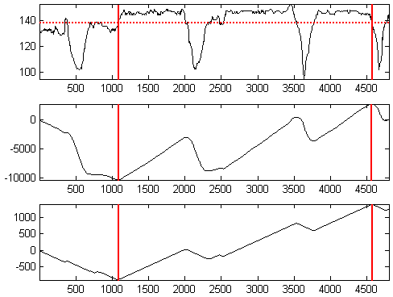
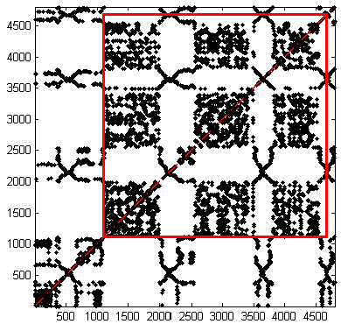
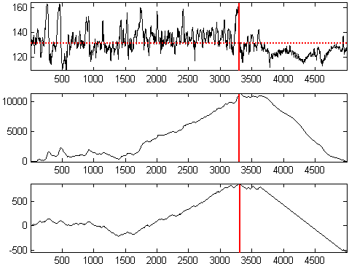
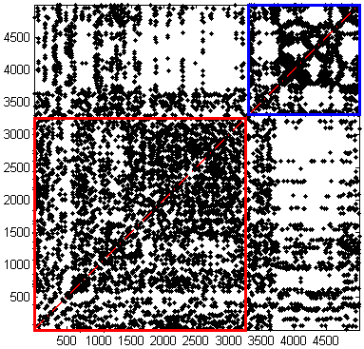
Stationary Segment Detection (1)

Slide 10
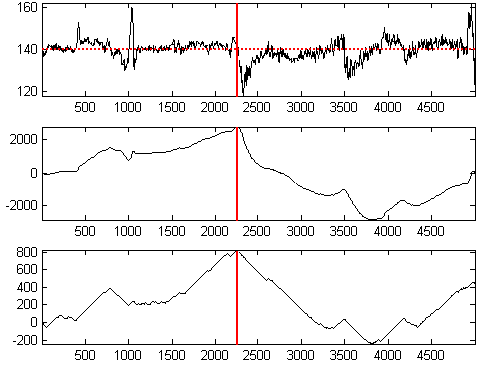
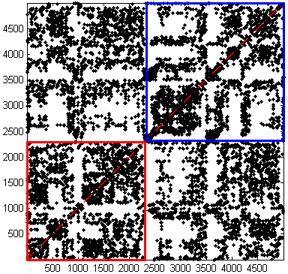
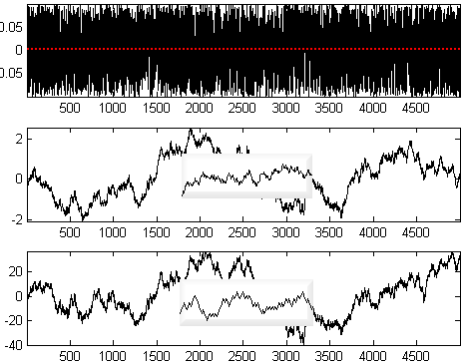
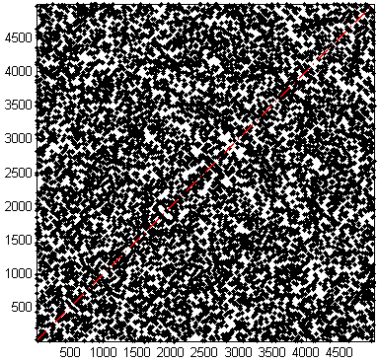
Stationary Segment Detection (2)
White Noise

Slide 11
Qualitative Interpretation of Recurrence Plot
Observation | Interpretation
Homogeneity | the process is obviously stationary
Fading to the upper left and lower right corners | nonstationarity; the process contains a trend or drift
Disruptions (white bands) occur | nonstationarity; some states are rare or far from the normal; transitions may have occurred
Periodic patterns | cyclicity in the process, the time distance between periodic patterns (e.g. lines) corresponds to the period
Single isolated points | heavy fluctuation in the process; if only single isolated points occur, the process may be an uncorrelated random process
Diagonal lines (parallel to the LOI) | the evolution of states is similar at different times; the process could be deterministic; if these diagonal lines occur beside single isolated points, the process could be chaotic (if these diagonal lines are periodic, unstable periodic orbits can be retrieved)
Diagonal lines (orthogonal to the LOI) | the evolution of states is similar at different times but with reverse time; sometimes this is a sign for an insufficient embedding
Vertical and horizontal lines/clusters | some states do not change or change slowly for some time; indication for laminar states
Long bowed line structures | the evolution of states is similar at different epochs but with different velocity; the dynamics of the system could be changing (but note: this is not fully valid for short bowed line structures)

Slide 12
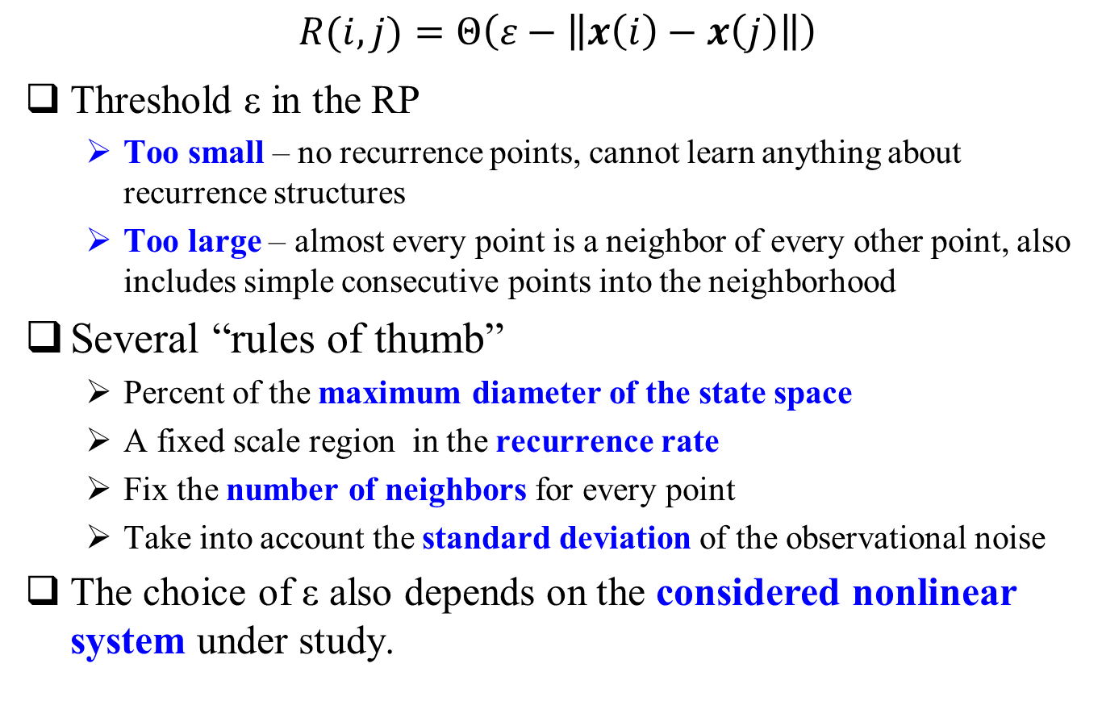
Selection of threshold ε
$$R(i,j)=Θ\left(ε−\left\|x\left(i\right)−x\left(j\right)\right\|\right)$$
Threshold ε in the RP
Too small – no recurrence points, cannot learn anything about recurrence structures
Too large – almost every point is a neighbor of every other point, also includes simple consecutive points into the neighborhood
Several “rules of thumb”
Percent of the maximum diameter of the state space
A fixed scale region in the recurrence rate
Fix the number of neighbors for every point
Take into account the standard deviation of the observational noise
The choice of ε also depends on the considered nonlinear system under study.

Slide 13
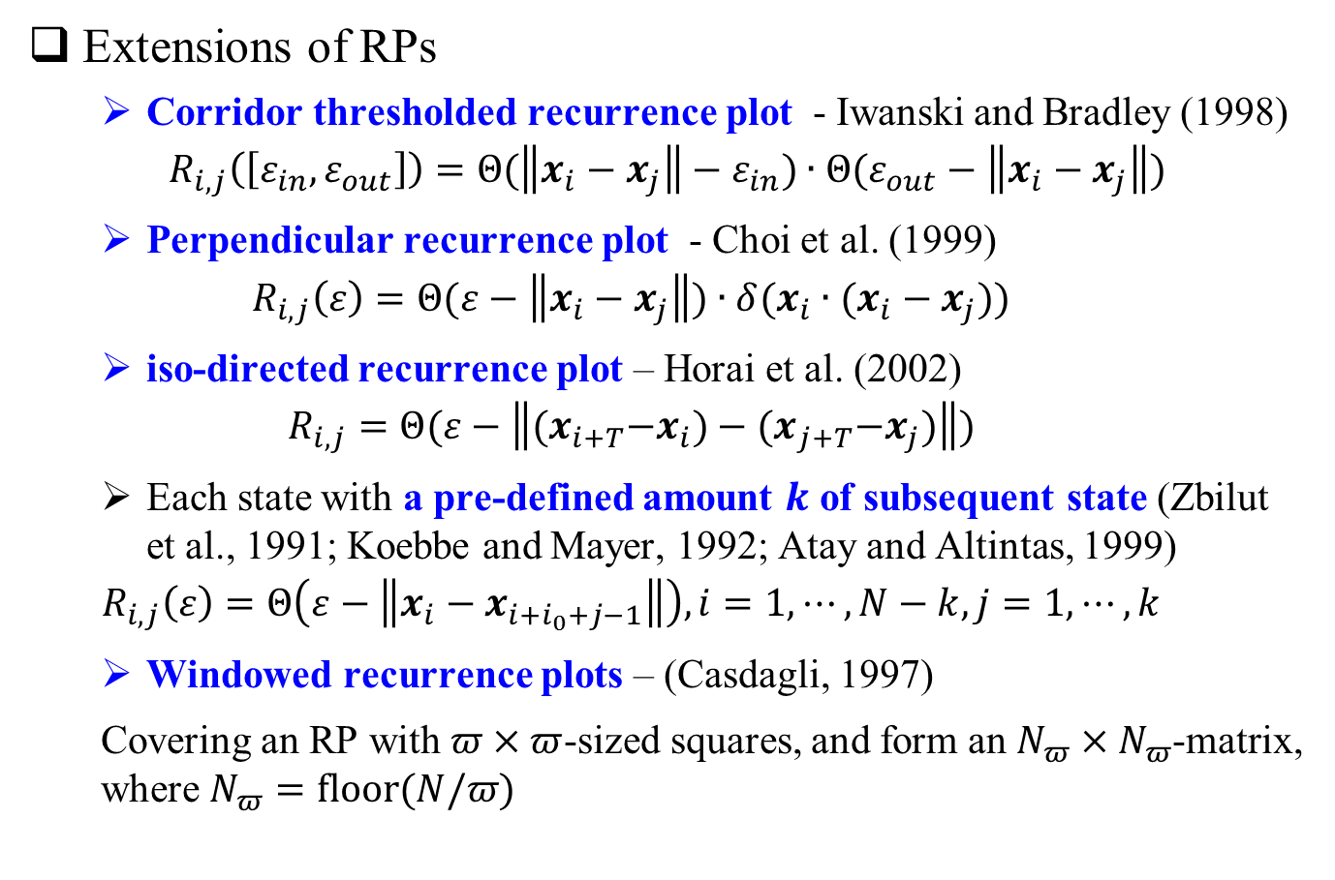
Modifications and Extensions
Extensions of RPs
Corridor thresholded recurrence plot - Iwanski and Bradley (1998)
$$R_{i,j}\left(\left[ε_{in},ε_{out}\right]\right)=Θ(\left\|x_{i}−x_{j}\right\|−ε_{in})∙Θ(ε_{out}−\left\|x_{i}−x_{j}\right\|)$$
Perpendicular recurrence plot - Choi et al. (1999)
$$R_{i,j}\left(ε\right)=Θ(ε−\left\|x_{i}−x_{j}\right\|)∙δ(x_{i}∙(x_{i}−x_{j}))$$
iso-directed recurrence plot – Horai et al. (2002)
$$R_{i,j}=Θ(ε−\left\|{(x}_{i+T}−x_{i})−{(x}_{j+T}−x_{j})\right\|)$$
Each state with a pre-defined amount $k$ of subsequent state (Zbilut et al., 1991; Koebbe and Mayer, 1992; Atay and Altintas, 1999)
$$R_{i,j}\left(ε\right)=Θ\left(ε−\left\|x_{i}−x_{i+i_{0}+j−1}\right\|\right), i=1,⋯,N−k, j=1,⋯,k$$
Windowed recurrence plots – (Casdagli, 1997)
Covering an RP with $π×π$-sized squares, and form an $N_{π}×N_{π}$-matrix, where $N_{π}=floor(N/π)$

Slide 14
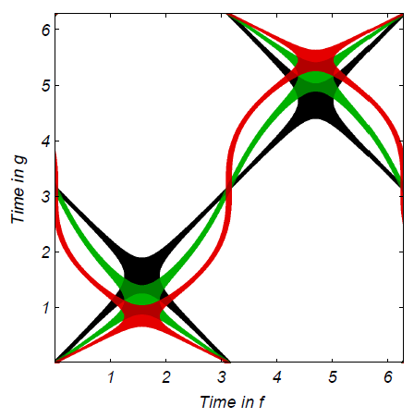
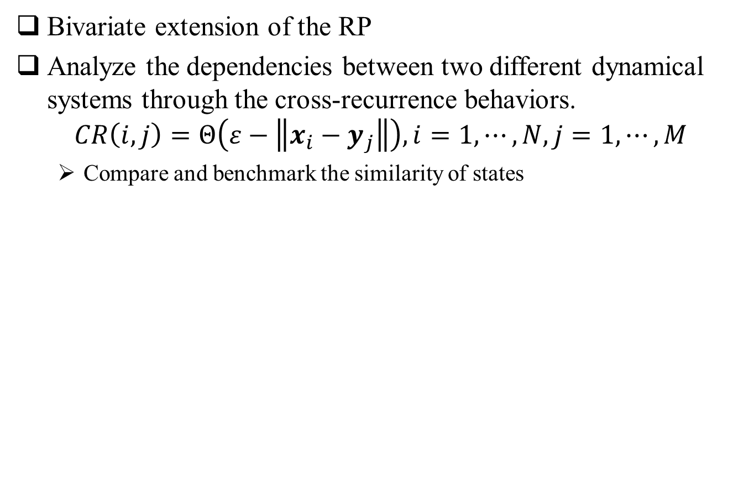
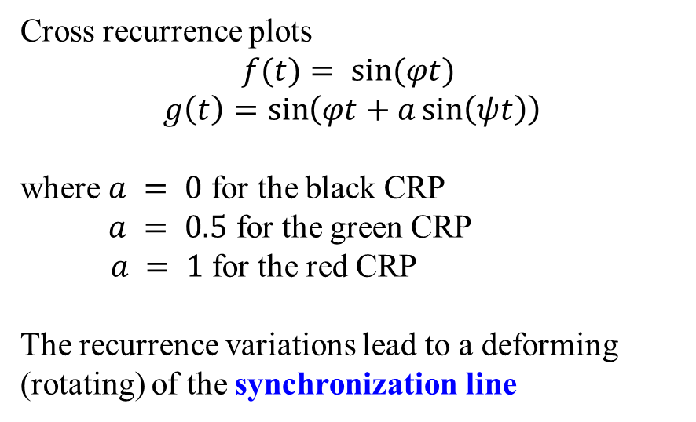
Cross Recurrence Plot
Bivariate extension of the RP
Analyze the dependencies between two different dynamical systems through the cross-recurrence behaviors.
$$CR\left(i,j\right)=Θ\left(ε−\left\|x_{i}−y_{j}\right\|\right), i=1,⋯,N, j=1,⋯,M$$
Compare and benchmark the similarity of states
Cross recurrence plots
$$f(t)= sin⁡(φt)$$
$$g\left(t\right)=\sin\left(φt+a\sin\left(ψt\right)\right)$$
where $a = 0$ for the black CRP
$a = 0.5$ for the green CRP
$a = 1$for the red CRP
The recurrence variations lead to a deforming (rotating) of the synchronization line

Slide 15
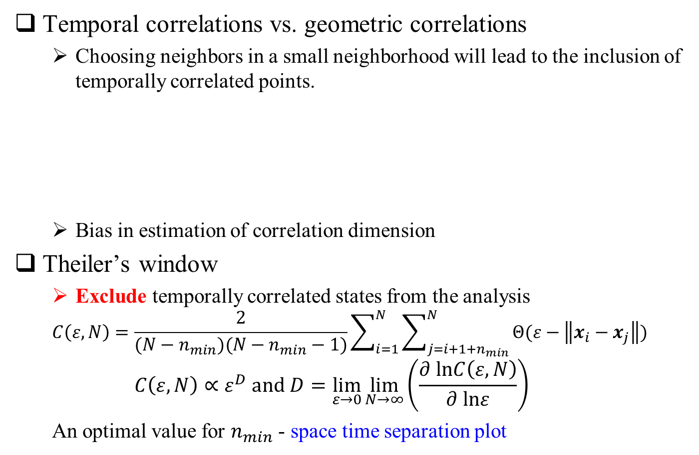
Correlation Sum
Temporal correlations vs. geometric correlations
Choosing neighbors in a small neighborhood will lead to the inclusion of temporally correlated points.
Bias in estimation of correlation dimension
Theiler’s window
Exclude temporally correlated states from the analysis
$$C\left(ε,N\right)=\frac{2}{(N−n_{min})(N−n_{min}−1)}\sum_{i=1}^{N}{\sum_{j=i+1+n_{min}}^{N}{Θ(ε−\left\|x_{i}−x_{j}\right\|)}}$$
$$C\left(ε,N\right)∝ε^{D} and D=\lim_{ε→0}{\lim_{N→∞}\left(\frac{∂ lnC\left(ε,N\right)}{∂ lnε}\right)}$$
An optimal value for $n_{min}$ - space time separation plot

Slide 16
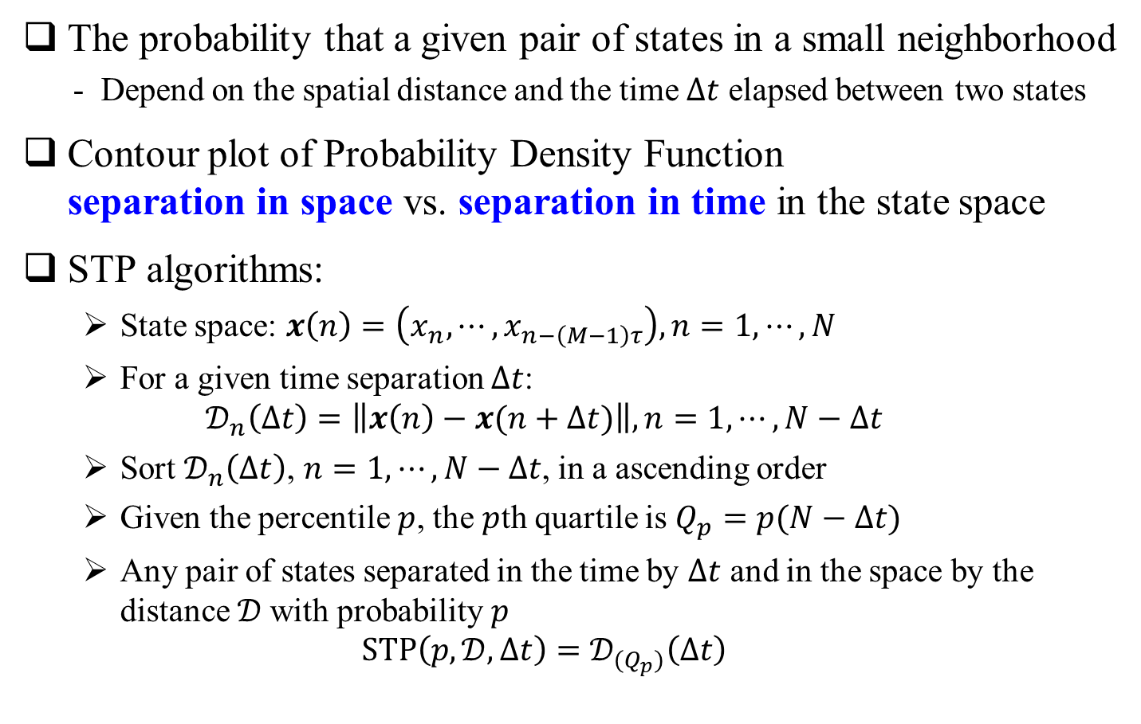
Space Time Separation Plot
The probability that a given pair of states in a small neighborhood
- Depend on the spatial distance and the time $∆t$ elapsed between two states
Contour plot of Probability Density Function separation in space vs. separation in time in the state space
STP algorithms:
State space: $x\left(n\right)=\left(x_{n},⋯,x_{n−\left(M−1\right)τ}\right), n=1,⋯,N$
For a given time separation $∆t$:
$$𝒟_{n}\left(∆t\right)=\left\|x\left(n\right)−x(n+∆t)\right\|, n=1,⋯,N−∆t$$
Sort $𝒟_{n}\left(∆t\right)$, $n=1,⋯,N−∆t$, in a ascending order
Given the percentile $p$, the $p$th quartile is $Q_{p}=p(N−∆t)$
Any pair of states separated in the time by $∆t$ and in the space by the distance $𝒟$with probability $p$
$$STP\left(p,𝒟,∆t\right)=𝒟_{(Q_{p})}\left(∆t\right)$$

Slide 17
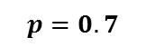
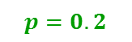


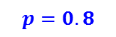
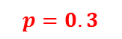
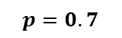
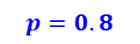
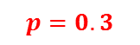
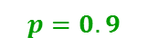





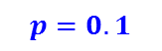
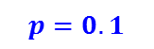
STP Examples
$$p=0.9$$
$$p=0.8$$
$$p=0.7$$
$$p=0.6$$
$$p=0.5$$
$$p=0.4$$
$$p=0.3$$
$$p=0.2$$
$$p=0.1$$
$$p=0.9$$
$$p=0.8$$
$$p=0.7$$
$$p=0.6$$
$$p=0.5$$
$$p=0.4$$
$$p=0.3$$
$$p=0.2$$
$$p=0.1$$

Slide 18
Recurrence Features
Quantifying the topological features of Recurrence Plots
Statistical features to quantify certain recurrence patterns from Recurrence Plot (Kantz, Marwan, and Kurths et al.):
Recurrence rate (%REC)
Determinism (%DET)
Linemax (LMAX)
Entropy (ENT)
Laminarity (%LAM)
Trapping time (TT)
Diagonal structures (first four) and vertical structures (last two) in the recurrence plot
Notes:
Recurrence plots(RP) are intricate and visually appealing, however we need methods to identify and classify the topological features of RPs. Not only the intriguing artistic graphical display but also the scientific meaning needs to be exploited.
The visual appearance of an RP gives hints about the dynamics of the system. The small-scale structures in RPs are used by the recurrence quantification analysis. This allows to describe the RPs by quantifying the topological features of them, and to study transitions or nonlinear parameters of the system.
Those statistical features including Recurrence rate; Determinism; Linemax ; Entropy; Laminarity and Trapping time.
First four features are from diagonal structures and the last two are from vertical structures.

Slide 19
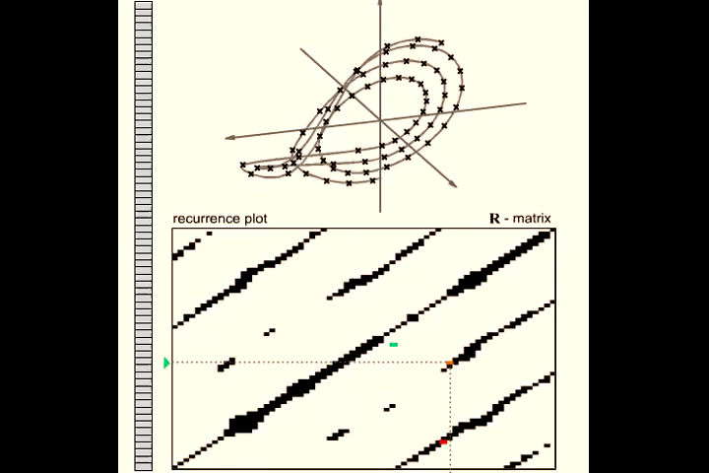
RQA − Histogram
N. Marwan, http://www.recurrence-plot.tk/

Slide 20
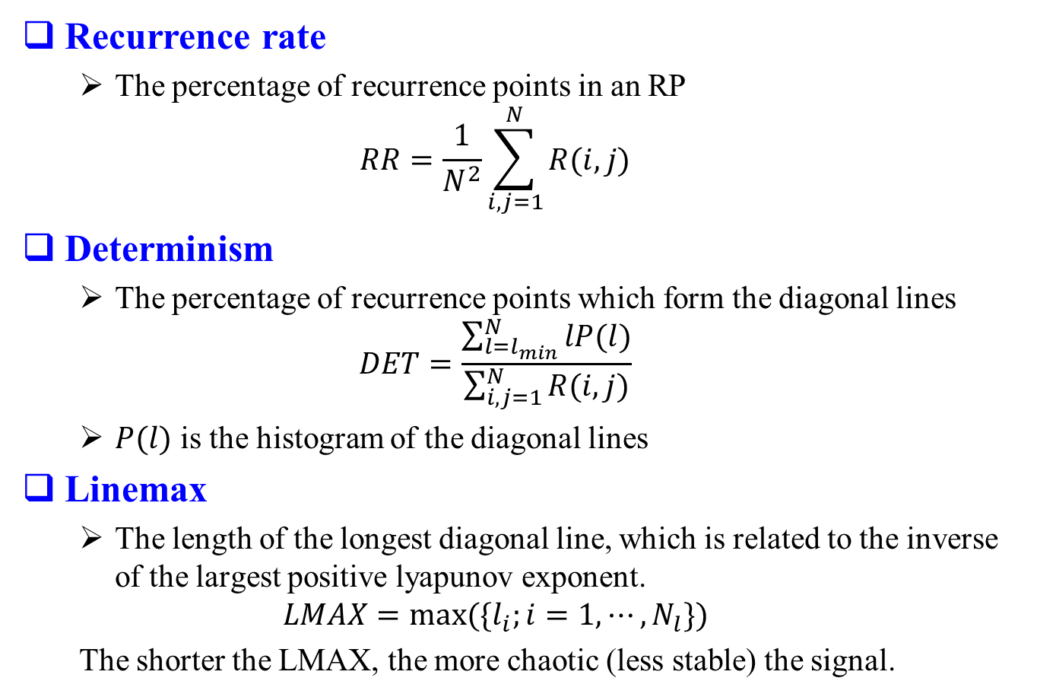
Recurrence Quantification Analysis
Recurrence rate
The percentage of recurrence points in an RP
$$RR=\frac{1}{N^{2}}\sum_{i,j=1}^{N}{R(i,j)}$$
Determinism
The percentage of recurrence points which form the diagonal lines
$$DET=\frac{\sum_{l=l_{min}}^{N}{lP(l)}}{\sum_{i,j=1}^{N}{R(i,j)}}$$
$P(l)$ is the histogram of the diagonal lines
Linemax
The length of the longest diagonal line, which is related to the inverse of the largest positive lyapunov exponent.
$$LMAX=max⁡(\{l_{i};i=1,⋯,N_{l}\})$$
The shorter the LMAX, the more chaotic (less stable) the signal.
Notes:
Recurrence rate (%REC)
The percentage of dark points on the TRP ( the pairs of points whose distance is less than the corridor).
%REC=100*(#recurrent points in triangle)/(W(W-1)/2)
W – window size
%REC range from 0% to 100%
Determinism (%DET)
The proportion of recurrent points forming diagonal line structures. It measures the repeating or deterministic patterns in the dynamics, that is, how “organized” the TRP is?
%DET=100*(#points in diagonal lines)/(#recurrent points)
Periodic signal – long diagonal lines (big %DET)
Chaotic signal – short diagonal lines (medium %DET)
Stochastic signal – no diagonal lines (near zero %DET)
Linemax (LMAX)
The length of the longest diagonal line segment in the TRP, which is related to the inverse of the largest positive lyapunov exponent.
LMAX=length of longest diagonal line in recurrence plot
The shorter the LMAX, the more chaotic (less stable) the signal.
Entropy (ENT)
The Shannon information entropy of all diagonal line lengths distributed over integer bins in a histogram. Predictability decreases with increasing entropy.

Slide 21
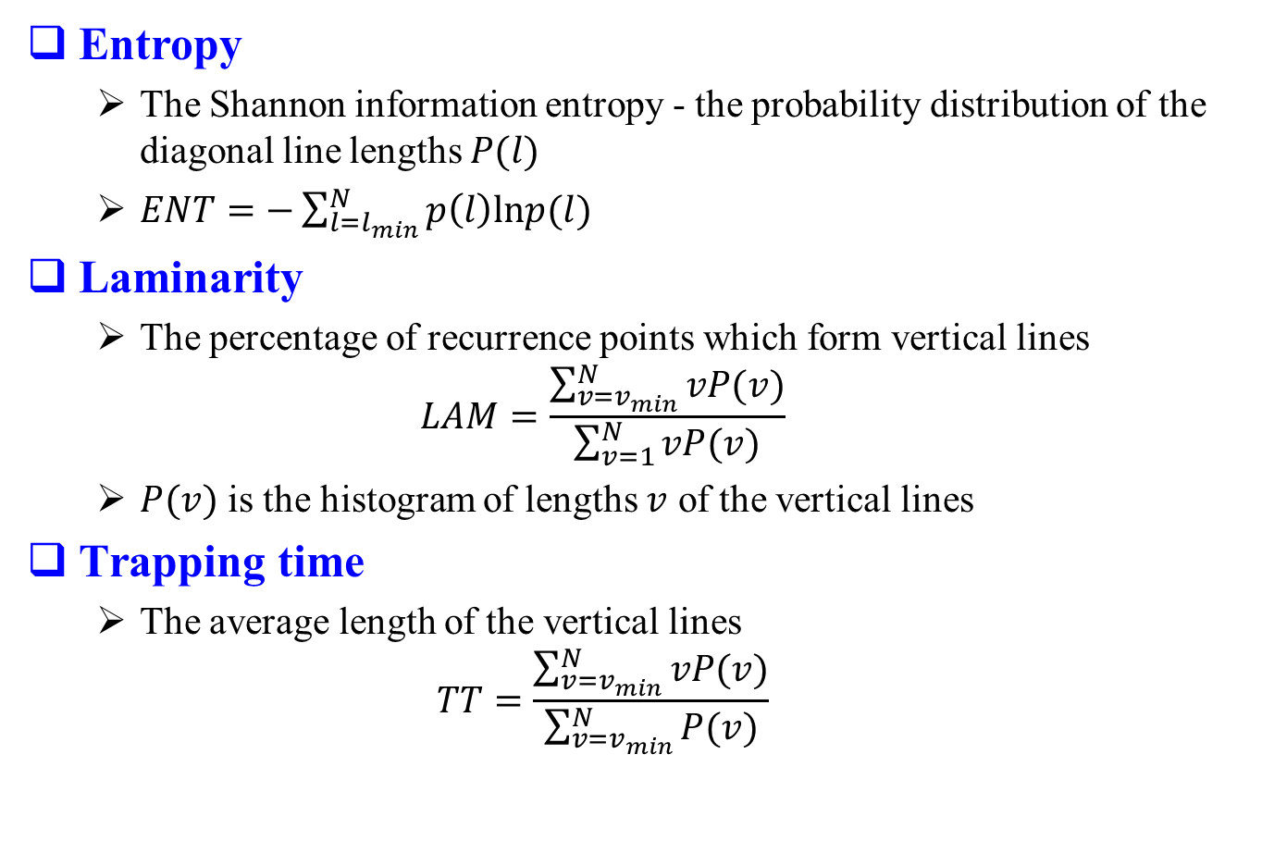
RQA (cont.)
Entropy
The Shannon information entropy - the probability distribution of the diagonal line lengths $P(l)$
$ENT=−\sum_{l=l_{min}}^{N}{p\left(l\right)lnp(l)}$
Laminarity
The percentage of recurrence points which form vertical lines
$$LAM=\frac{\sum_{v=v_{min}}^{N}{vP(v)}}{\sum_{v=1}^{N}{vP(v)}}$$
$P(v)$ is the histogram of lengths $v$ of the vertical lines
Trapping time
The average length of the vertical lines
$$TT=\frac{\sum_{v=v_{min}}^{N}{vP(v)}}{\sum_{v=v_{min}}^{N}{P(v)}}$$
Notes:
Laminarity (%LAM) & Trapping time (TT)
%LAM is analogous to %DET except that it measures the vertical line structures.
%LAM = 100*(#points in vertical lines)/(#recurrent points)
TT is the average length of vertical line structures.
TT = mean (length of vertical lines)

Slide 22
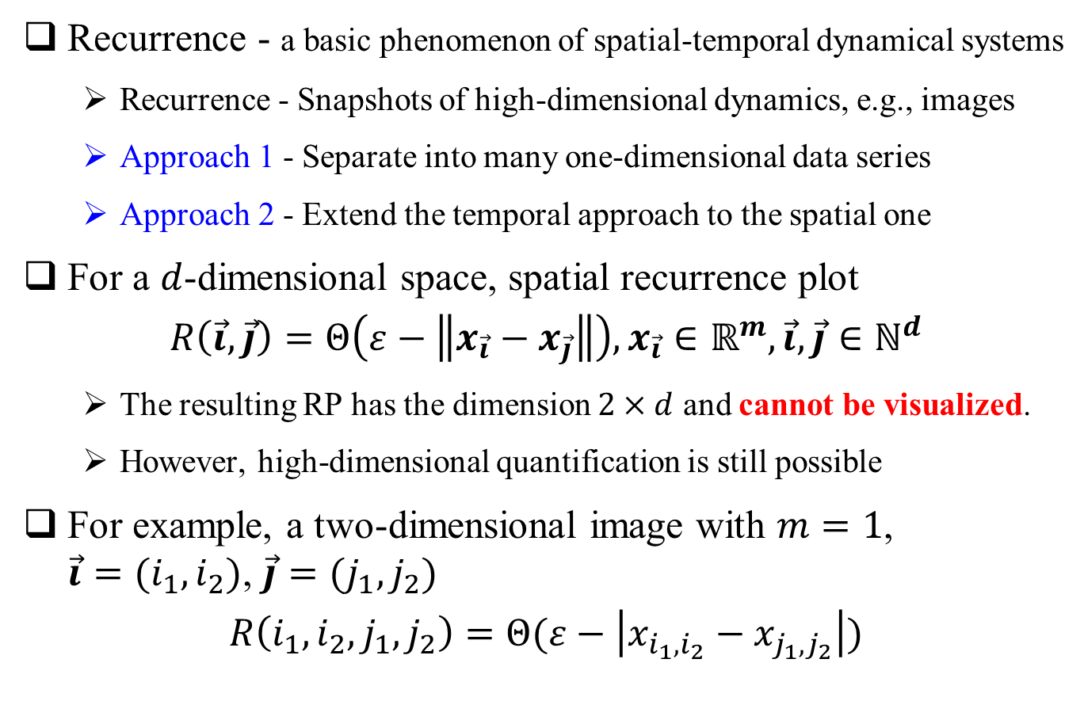
Extension to spatial data
Recurrence - a basic phenomenon of spatial-temporal dynamical systems
Recurrence - Snapshots of high-dimensional dynamics, e.g., images
Approach 1 - Separate into many one-dimensional data series
Approach 2 - Extend the temporal approach to the spatial one
For a $d$-dimensional space, spatial recurrence plot
$$R\left(\vec{i},\vec{j}\right)=Θ\left(ε−\left\|x_{\vec{i}}−x_{\vec{j}}\right\|\right),x_{\vec{i}}∈ℝ^{m}, \vec{i},\vec{j}{∈ℕ}^{d}$$
The resulting RP has the dimension $2×d$ and cannot be visualized.
However, high-dimensional quantification is still possible
For example, a two-dimensional image with $m=1$, $\vec{i}=(i_{1},i_{2})$, $\vec{j}=(j_{1},j_{2})$
$$R\left(i_{1},i_{2},j_{1},j_{2}\right)=Θ(ε−\left|x_{i_{1},i_{2}}−x_{j_{1},j_{2}}\right|)$$

Slide 23
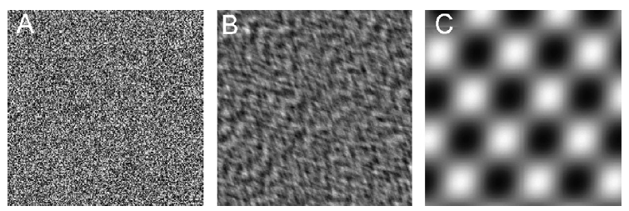
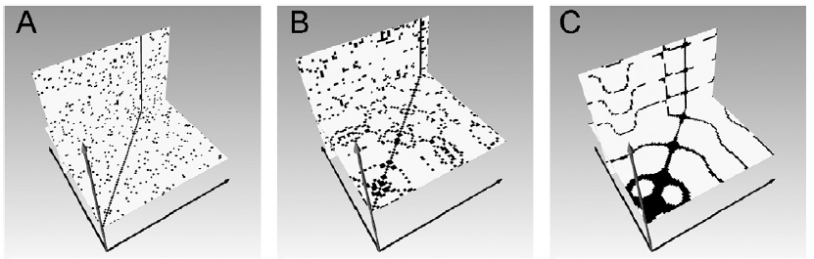
SRP Examples
Two-dimensional spatial data examples
Uniformly white noise
Auto-regressive process
Periodically recurring

Slide 24
References
The tutorial slides are made to introduce the concept of recurrence plots based on the materials from http://www.recurrence-plot.tk/, Dr. Norbert Marwan

Slide 25
END Questions?

